Slide 1

Project Management

Slide 2


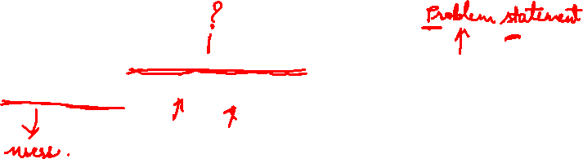
Definition
“A project is a temporary endeavor undertaken to create a unique product, service, or result.”

Slide 3

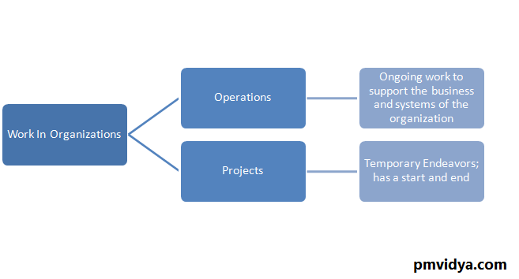


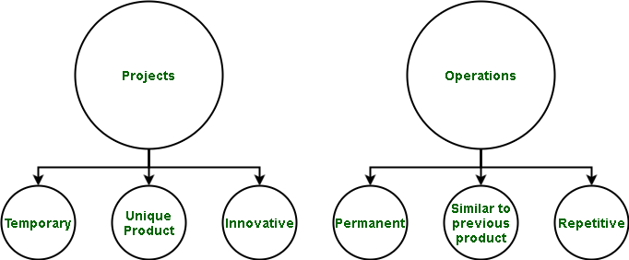
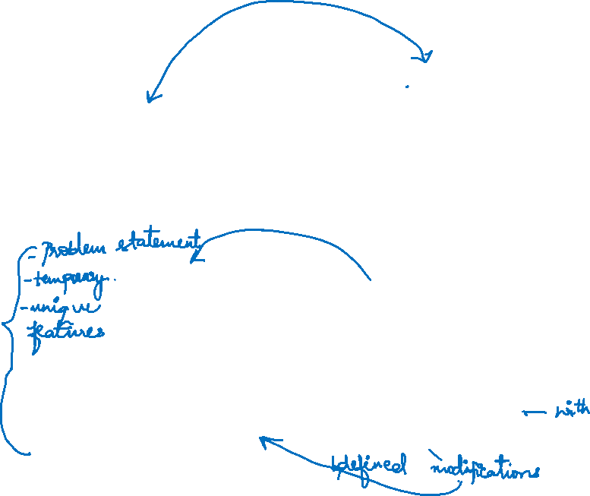
Project Vs Operations

Slide 4
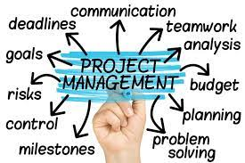
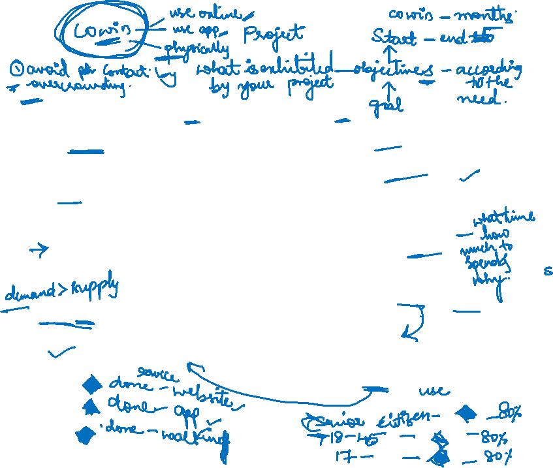
Necessity of project management

Slide 5
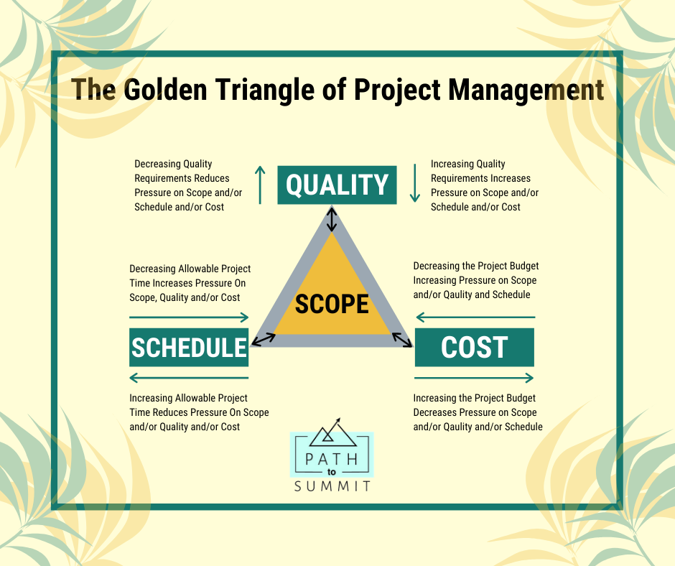
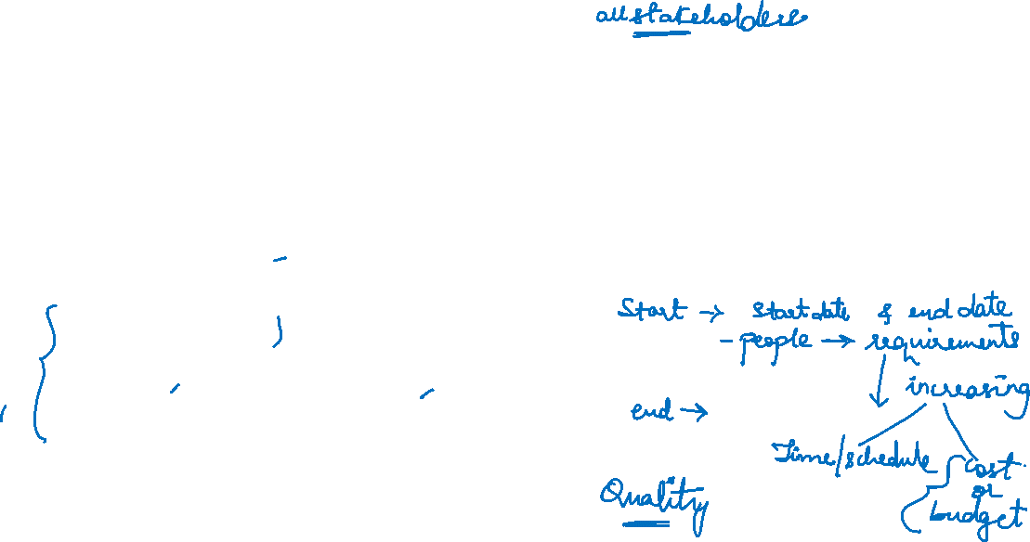
Triple constraints

Slide 6
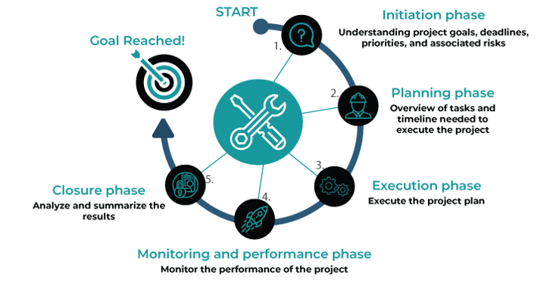
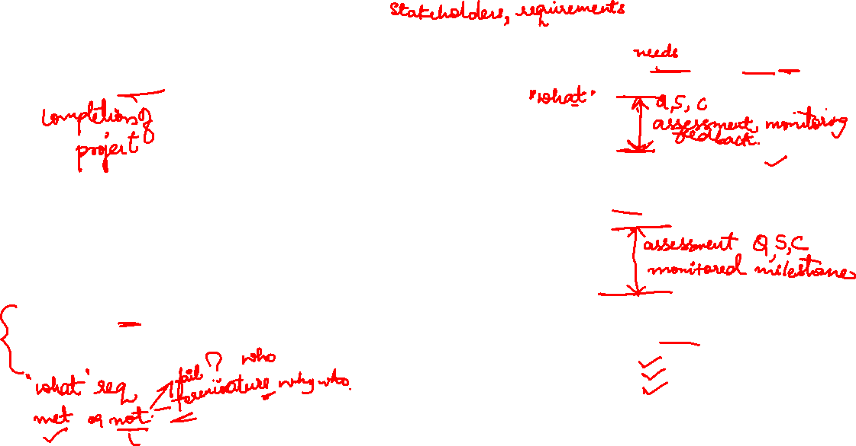

Slide 7
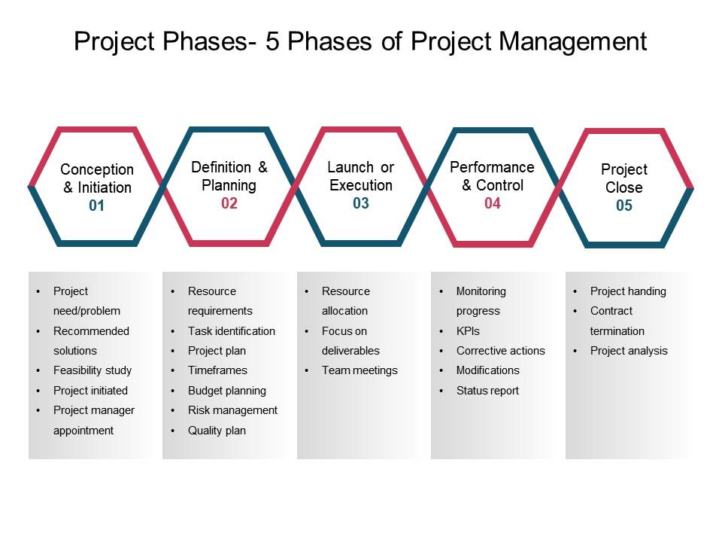
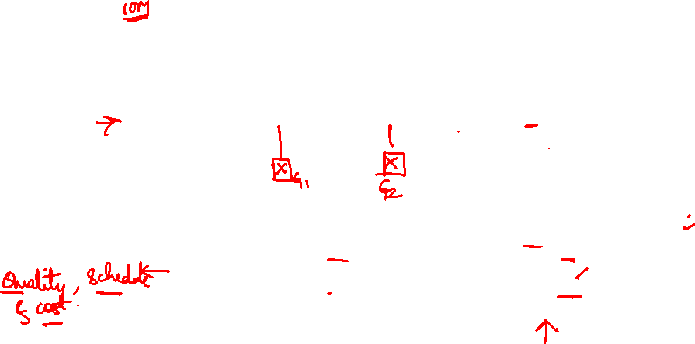

Slide 8
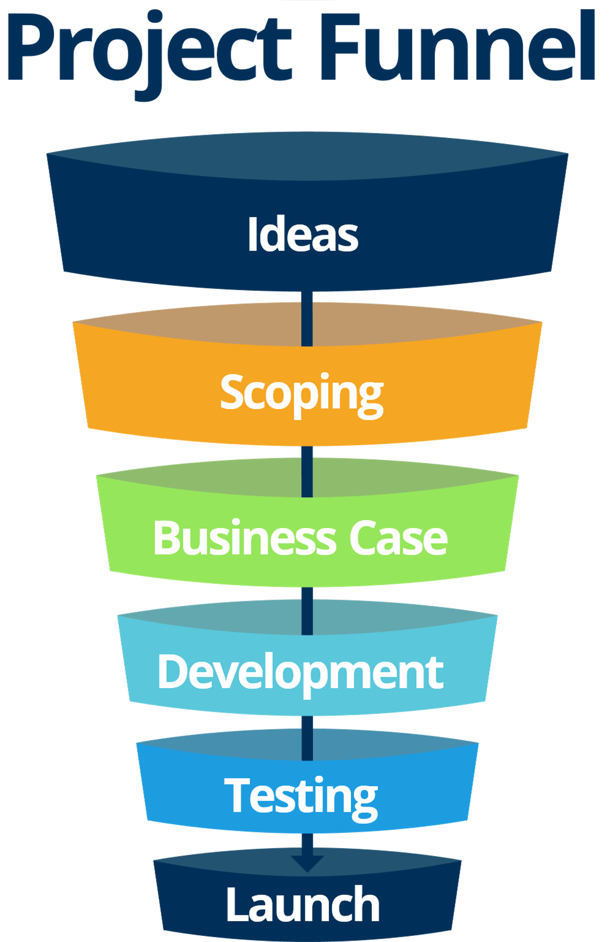
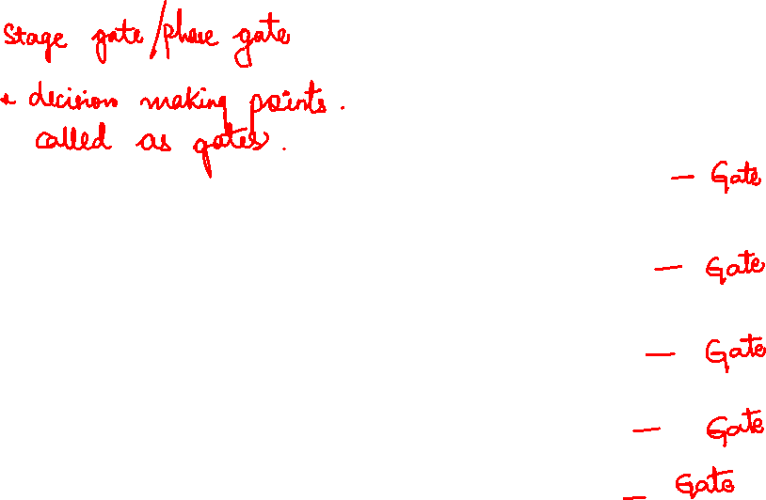

Slide 9
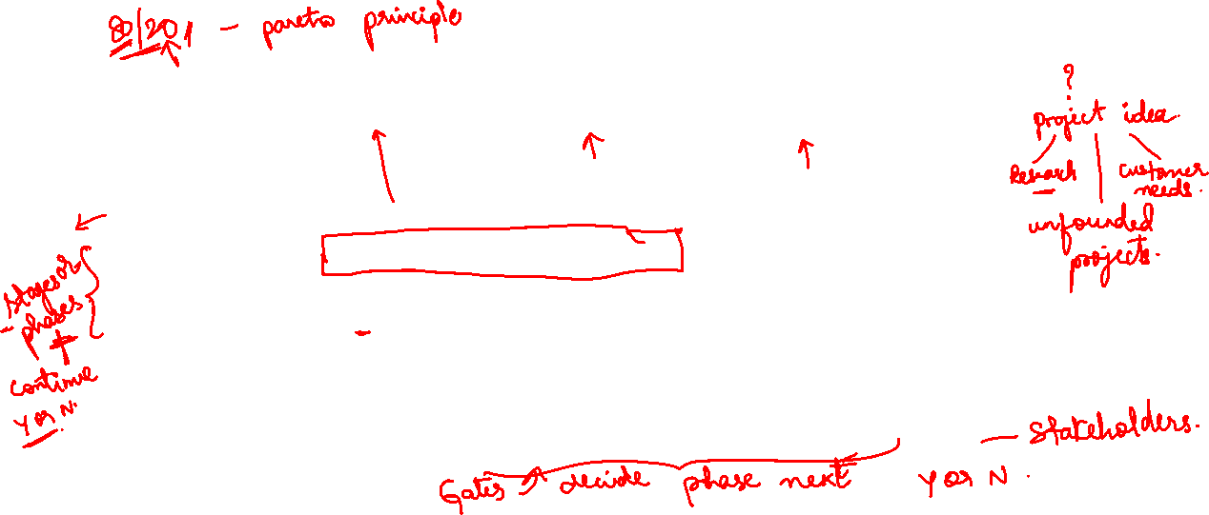
Phase Gate in Project Management
The product development process starts with an idea originating from basic research, seed or
unfounded projects, customer-based techniques, and creativity techniques.
● A phase-gate process (also referred to as a stage-gate process) is a project management
technique in which an initiative or project is divided into distinct stages or phases, separated by
decision points (known as gates).
● Decisions regarding the continuity of product development are taken at certain decision points
termed “gates”
● Continuation is decided by (typically) a manager, steering committee, or governance board.

Slide 10
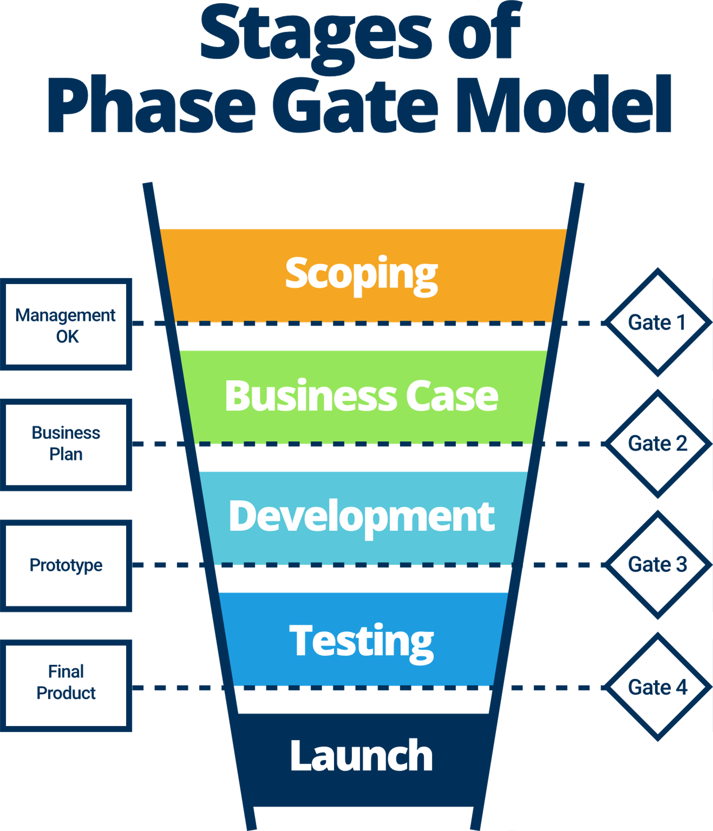
The various stages given in the conventional model are
● Scoping (Preliminary Analysis Phase)
● Build Business Case
● Development
● Testing and Validation
● Launch
There are 5 stages and normally a gate after every stage. There is also a
zeroth stage called Discovery (Ideation Phase) and a 6th stage called a
Post-Launch Review.

Slide 11
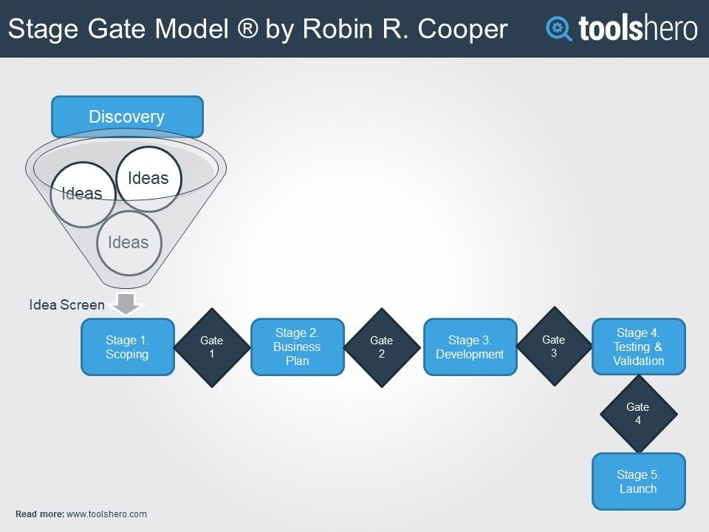


Slide 12

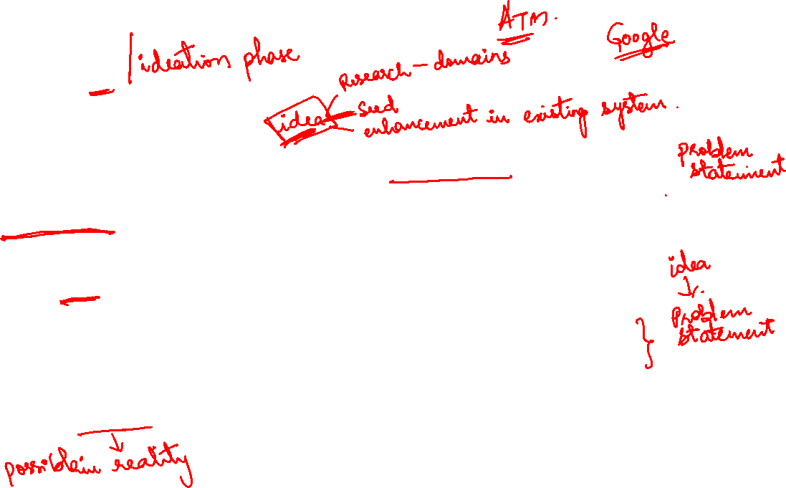
Discovery
Every project is kickstarted with a preliminary ideation phase. It’s during this phase that the project actually starts to take shape.
Stakeholders will gather into breakout sessions and participate in group
brainstorming meetings.
Inspiration can come from anywhere.
Once the idea becomes more concrete, key stakeholders will gather and discuss the resources needed, the project scope and the financial buy-in required to make this project a success.
The criteria in this gate revolve around the suitability in the company and the feasibility of the idea.

Slide 13
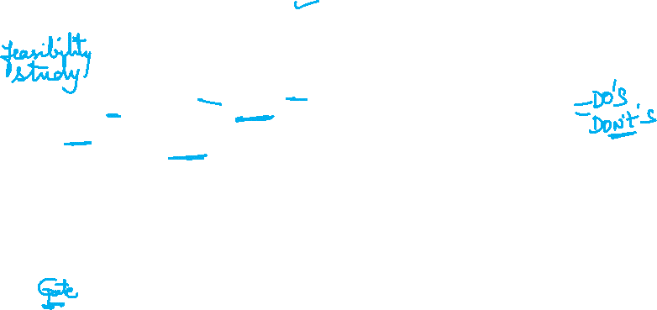
Scoping
The pre-construction phase.
● The company now has a new product/business opportunity in mind with an outline on how to achieve
● Identifying strengths and weaknesses of the product will help stakeholders take a 360-degree view of the new project.
● Determine risk factors.
● Examine how detrimental a product launch could mean for your place in the market,
● The end of every phase is the opportunity to have leadership decide on whether or not to kill the project or continue forward.
● This gate, customer needs and technical requirements need to be specified

Slide 14

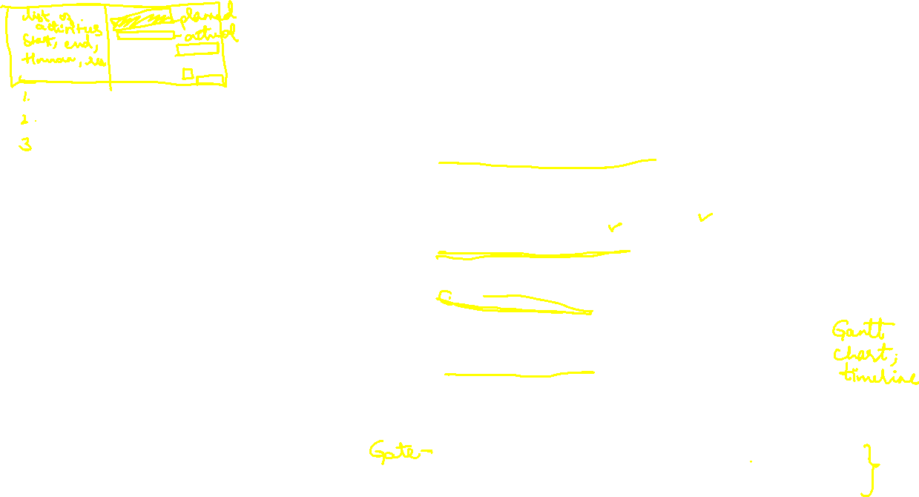
Business Plan
This phase is typically resource-intensive and includes four key steps:
● Define & Analyze Your Product:
− Considers research from Phase 1 and include data such as target demographics, if this fills a customer need currently unmet by anyone else on the market, etc.
● Build your Business Case:
− defining your product and the reason for building it.
● Build your Project Plan: Think of this as a project plan within a project plan.
− This includes a list of tasks, resources, a timeline, etc.
● Review the Feasibility:
− Consider all risks and assess the resources, time and money needed to make this project happen successfully, and review if it’s possible.
− This gate requires detailed information about market, technical aspects and costs as well as potential risks and suitability to corporate strategy

Slide 15
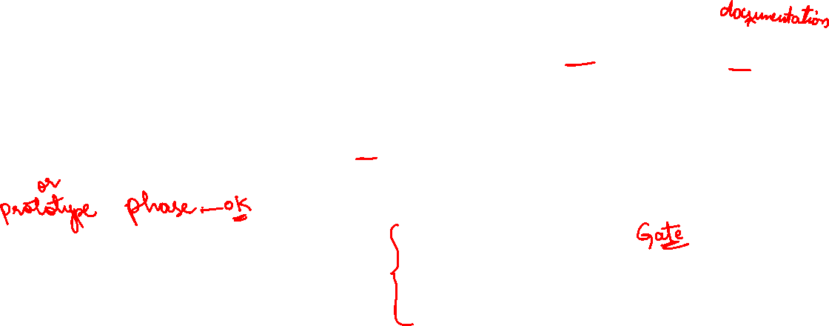
Development
This is where all key stakeholders and investors get started.
The dev team starts developing
The copy team starts writing, and
The design team starts designing.
It’s in this phase where all the details of the project have been mostly ironed out, and the product really starts to take shape. This is
also known as the prototype phase.
During this stage the financial estimations are also updated to be more relevant before the next gate.
A final product specification

Slide 16

Testing & Validation
This phase effectively acts as the quality assurance phase.
● Bugs are ironed out; edits are made to the prototype, and final touches are
made on all design and copy.
● It’s also in this phase where you can do some light market/field testing.
● Get a group together of people unrelated to the company and have them
test out the user experience of the product that you’re building out.

Slide 17

Launch
After all of the stakeholders have signed off on the
product, everything has been tested for quality assurance,
and the product is launched,
● The product managers and leadership review the success
of the phase-gate process.
− What were the successes of the product?
− What were areas that could be improved upon both on a
team-specific level and a company-wide level?

Slide 18

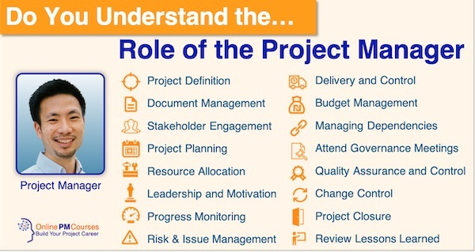
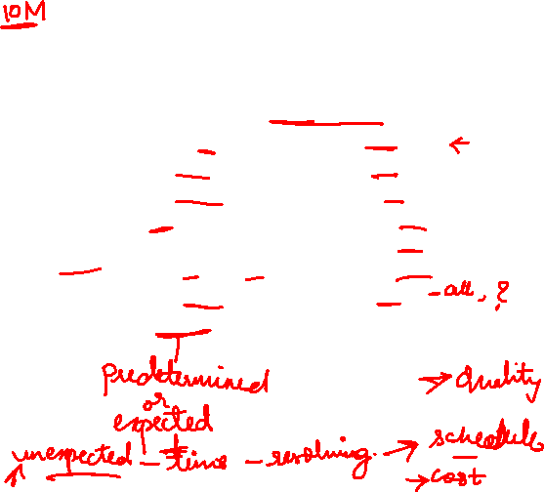
Managing the project team is an ongoing responsibility of the project manager. The team is monitored to make sure they’re working productively and that there are no internal conflicts, so everyone is satisfied.

Slide 19
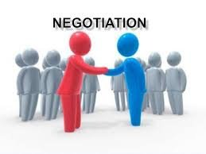
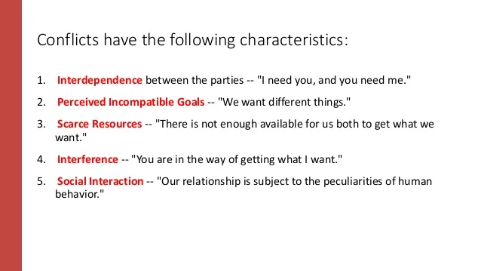

Slide 20


conflict or negotiation
A conflict or negotiation situation is one in which there is a conflict of interests or what one wants isn't necessarily what the other wants and where both sides prefer to search for solutions, rather than giving in or breaking-off contact.
There can be positive and negative outcomes as seen in the box below. It can be destructive but can also play a productive role for you personally and for your relationships-both personal and professional. The important point is to manage the conflict, not to suppress conflict and not to let conflict escalate out of control. Many of us seek to avoid conflict when it arises but there are many times when we should use conflict as a critical aspect of creativity and motivation.

Slide 22
Major Causes of Conflict
Opposing interests (or what we think are opposing interests) are at the core of most conflicts.
In a modern complex society, we confront these situations many times a day.
The modern organization adds a whole new group of potential causes of conflict that are already present:
• competition over scarce resources, time
• ambiguity over responsibility and authority:
• differences in perceptions, work styles, attitudes, communication problems, individual differences
• increasing interdependence as boundaries between individuals and groups become increasingly blurred
• reward systems: we work in situations with complex and often contradictory incentive systems
• differentiation: division of labor which is the basis for any organization causes people and groups to see situations differently and have different goals
• equity vs. equality: continuous tension exists between equity (the belief that we should be rewarded relative to our relative contributions) and equality (belief that everyone should receive the same or similar outcomes).

Slide 23
PMI
PMBOK stands for Project Management Body of Knowledge. It is a set of standard terminology and guidelines for project management published and updated by The Project Management Institute (PMI).

Slide 24



PM knowledge areas as per Project Management Institute (PMI)
1. Project Integration Management
2. Project Scope Management
3. Project Time Management
4. Project Cost Management
5. Project Quality Management
6. Project Human Resource Management
7. Project Communications Management
8. Project Risk Management
9. Project Procurement Management
10. Project Stakeholder Management

Slide 25
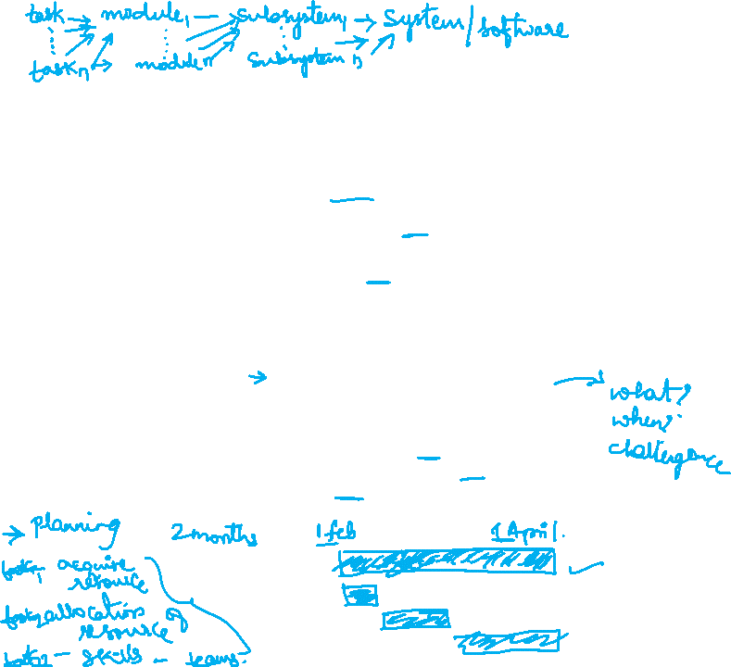
Project Integration Management
What holds a project together? That would be project integration management, which includes such fundamental plans as developing a project charter that is created during the initiation phase. This is the document that sets up the project and assigns the project manager.
Another aspect of this area is the project management plan, which is developed as a project roadmap for the project to reach a successful end. Once created, the project plan is approved by stakeholders and/or sponsors, and then it’s monitored and tracked through a change log as the project progresses.

Slide 26
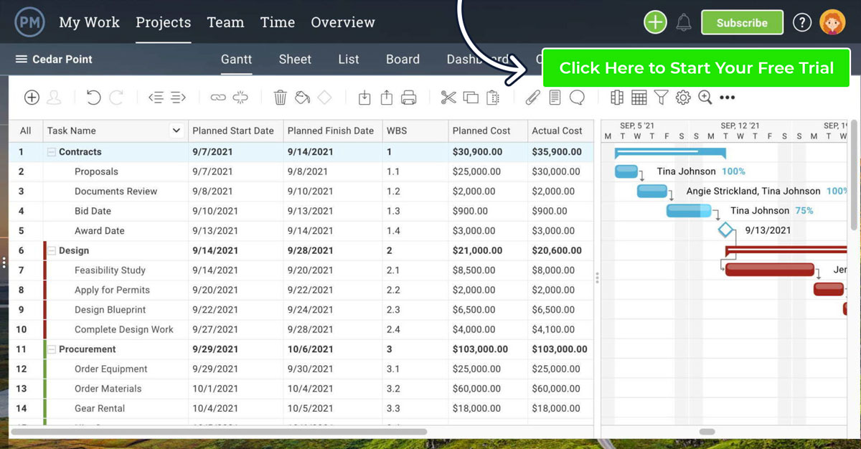
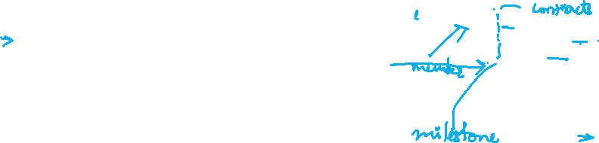
Project management plan

Slide 27

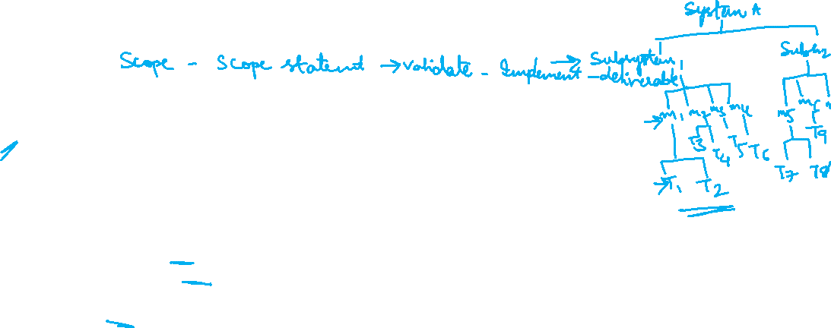
2. Project Scope Management
Scope relates to the work of the project. So, that includes plan scope management, which is part of the project management plan. It also is when a detailed requirement for the final product or service is collected.
You’ll also need to define scope in a scope statement. This is anything from a sentence to a bulleted list that is comprehensive to reduce major project risks. And a work breakdown structure (WBS), which is a graphic breakdown of project work, is another part of this area.
Validate scope during the project, which means making sure that the deliverables are being approved regularly by the sponsor or stakeholder. This occurs during the monitoring and controlling process groups and is about accepting the deliverables, not the specs laid out during planning.
The scope statement is likely going to change over the course of the project to control the scope, such as if a project falls behind schedule.

Slide 28
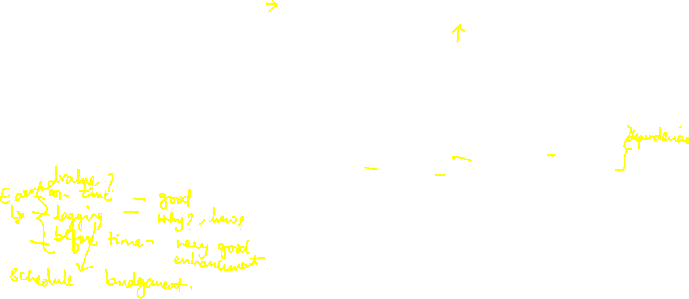
3. Project Time Management
Project time management is, time consuming. The project is divided into tasks, which are scheduled with start dates and deadlines, as well as budgets for each task. And things are constantly changing over the phases of any project, which means revising these things often.
This involves plan schedule management, which involves creating a schedule for the project and determining who is responsible for what. That means defining activities, which is not the same as making a WBS, but similar. So, you create a task list that touches on every aspect of the project.
These tasks are then put in an order that makes sense, and any dependencies between them is noted. These dependencies are then determined to be either finish-to-start (FS), finish-to-finish (FF), start-to-start (SS) or start-to-finish (SF). This is mostly for larger projects.
With the tasks now sequenced, the resources required for each must be estimated and assigned. The duration of each task is also determined at this point. All this will lead to a schedule by first figuring out the critical path and float for each task. Use a Gantt chart to place the tasks on a timeline, and then work on resource leveling to balance resource usage.
Once the schedule is made, plan to control the schedule are necessary. Earned value management is performed regularly to make sure that the actual plan is proceeding as it had been planned.

Slide 29
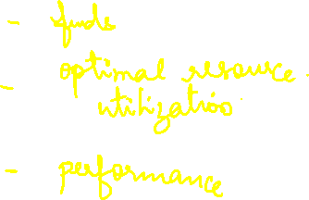
This area involves the project budget, which means having good estimating tools to make sure that the funds cover the extent of the project and are being monitored regularly to keep stakeholders or sponsors informed.
Plan cost management will determine the method to establish the budget, which includes how and if it will change and what procedures will be used to control it. Each task will have to be estimated for cost, which means including all resources such as labor, materials, equipment and anything else needed to complete the task.
This will determine the project budget, once you take all the task costs and combine them. Then comes the need to control those cost through an earned value analysis. This is performed regularly throughout the project to make sure the estimated costs are in line with actual expenditures.
4. Project Cost Management

Slide 30
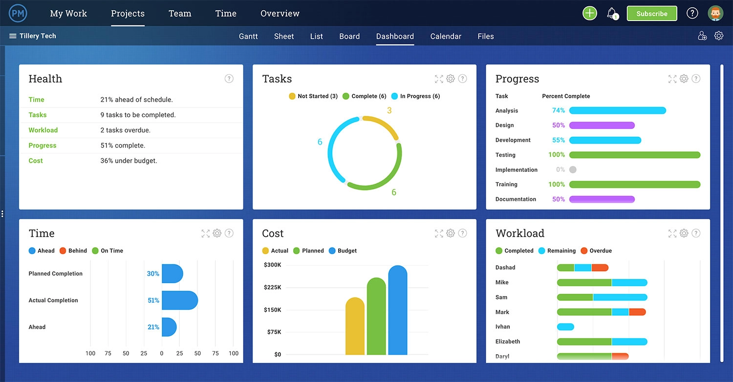

Slide 31
5. Project Quality Management
A project can come in on time and within budget, but if the quality is not up to the standard set, then the project is a failure. Plan quality management is part of the overall project management plan, though it can be a standalone document if it contains the quality specs for the product or service.
The process needs to include quality assurance, which is just a way to make sure that quality standards are being met. Therefore, to control quality, the deliverables must be inspected to make sure that those standards outlined in the quality management plan are being met.

Slide 32
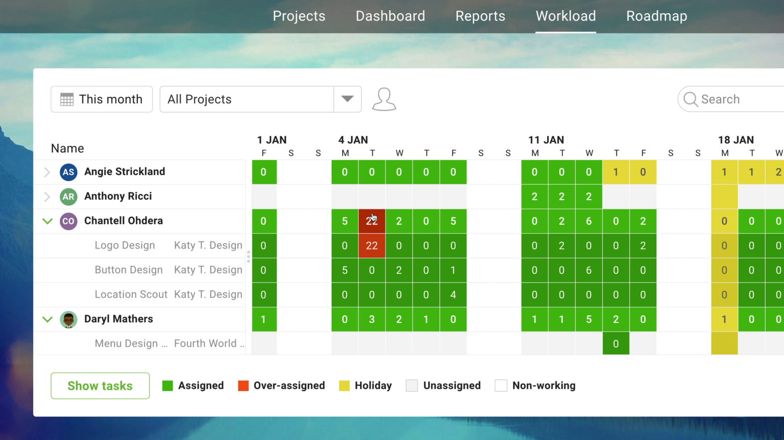
6. Project Human Resource Management
The project team is your most important resource, so it’s crucial to assemble the best team and to make sure they’re happy. But also you need to track their performance to ensure that the project is progressing as planned. A human resource management plan will identify their roles and their requirements for those positions, as well as how they fit in the overall project structure.
After you’ve determined the job descriptions, it’s time to fill those positions and acquire a project team. This can be done in-house by drawing from other departments in the organization, by getting new hires or by a combination of both. The team needs development, possibly training and other things that will make them viable for the project.

Slide 33
7. Project Communications Management
All areas of project management are important, but communication management might be paramount as it informs every aspect of the project. Communications inform the team and stakeholders, therefore the need to plan communications management is a critical step in any project.
Related: Free Communication Plan Template
It is at this point that the dissemination of communications is determined, including how it’s done and with what frequency. Target who needs what and when. Also, note how communications will occur when issues arise in the project, such as changes.
Manage the communications when the project is executed to make sure it runs as planned. This will also involve controlling communications by reviewing their effectiveness regularly and adjusting as needed.

Slide 34
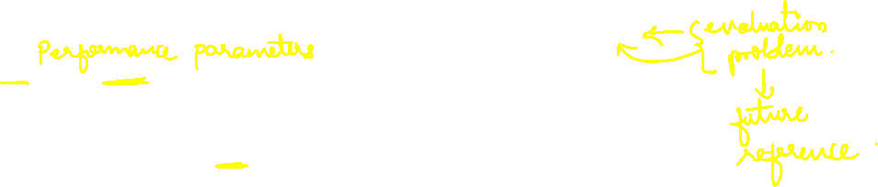
8. Project Risk Management
Risk management plans will identify how the risks will be itemized, categorized and prioritized. This involves identifying risks that might occur during the execution of the project by making a risk register.
Perform qualitative risk analysis after the biggest risks have been identified and classified by likelihood and impact. Then prioritize them. Then perform quantitative analysis according to their impact on the project, such as its budget, schedule, etc.
Now you’ll need to plan risk responses. If those risks in fact become issues, then a response needs to have been written in advance, with an owner who can make sure the risk is properly identified and handled. Controlling risk involves regularly reviewing the risk register and crossing off those risks that are no longer going to impact the project.

Slide 35
9. Project Procurement Management
This deals with outside procurement, which is part of most projects, such as hiring subcontractors. This will obviously have an impact on the budget and schedule. Planning procurement management starts by identifying the outside needs of the project and how those contractors will be involved.
Now conduct those procurements by hiring the contractors, which includes a statement of work, terms of reference, request for proposals and choosing a vendor. You’ll want to control the procurement process by managing and monitoring, and then closing the contracts once the work has been done to everyone’s satisfaction.

Slide 36
10. Project Stakeholder Management
The stakeholders must be happy, as the project has been created for their needs. Therefore, they must be actively managed like any other part of the project. To start one must identify the stakeholders through stakeholder analysis. It’s not always easy, but it’s a crucial part of starting any project, so find out who they are and what concerns they have.
Now plan stakeholder management, which means listing each stakeholder and prioritizing what their concerns are and how they might impact the project. This will lead to managing stakeholders’ expectations to make sure their needs are met and that you’re in communication with them.
Throughout the project, control stakeholder engagement. Do this by determining if the stakeholders’ needs are being addressed. If not, figure out what changes need to be made to either satisfy those needs or adjust the expectations.

Slide 37
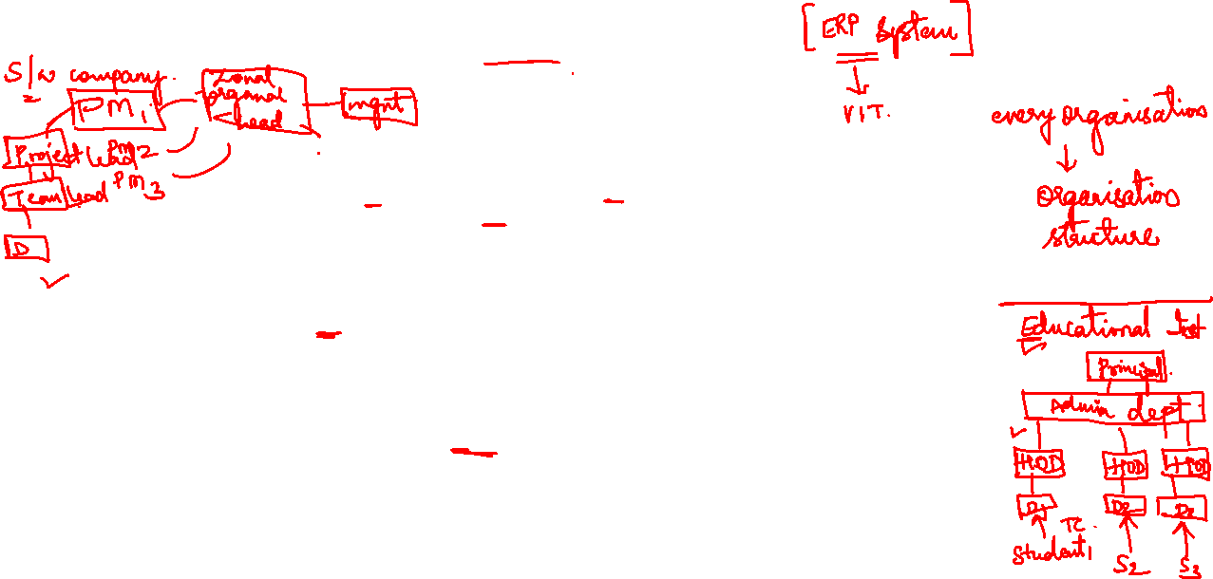
PM organisation structure

Slide 38
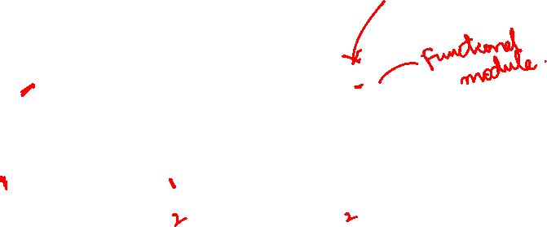

Slide 39
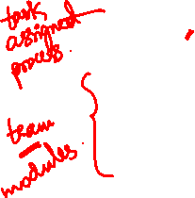

Slide 40
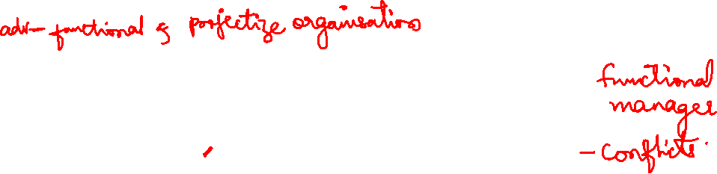

Slide 41
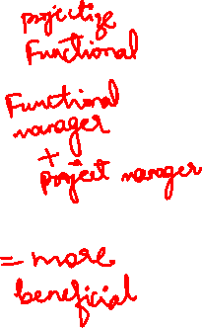

Slide 42
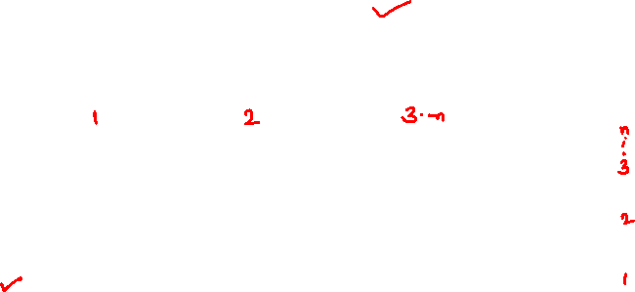

Slide 44
